Slide 1


University of Primorska
dr.Jamolbek Mattiev
Title: Word Game Modeling using Character-level N-gram and Statistics
Co-author: Ulugbek Salayev
16.01.2023 Koper

Slide 2
Content
Introduction
Problem Statement
Data Preparation
Statistics
Developed models
Experimental evaluations and conclusion

Slide 3
Introduction
The word games are one of the most essential factors of vocabulary learning and matching letters to form words for children aged 5-12. These games help children to improve letter and word recognition, memory-building and vocabulary retention skills.
The matching letter game (MLG) aims to construct words by using letter cubes. The MLG forms various skills on transform letters into words for children.
In this seminar, we develop two models for designing the cubic-letter game also known as the matching-letter game consists of a predefined number of cubes with a letter on every six sides, and word cards to form those words using a combination of cubes for the Uzbek language.

Slide 4
Contributions and goals
Since Uzbek is one of the low-resourced languages and there are not enough datasets, We created a novel dataset for the Uzbek language to conduct this researchThe matching letter game (MLG) aims to construct words by using letter cubes. The MLG forms various skills on transform letters into words for children.
We develop new models by using character-level N-gram and statistics to design a cubic-oriented matching letter game for the Uzbek and other languages.
Experimental evaluations on 4 datasets have been performed to show the advantage of our methods

Slide 5
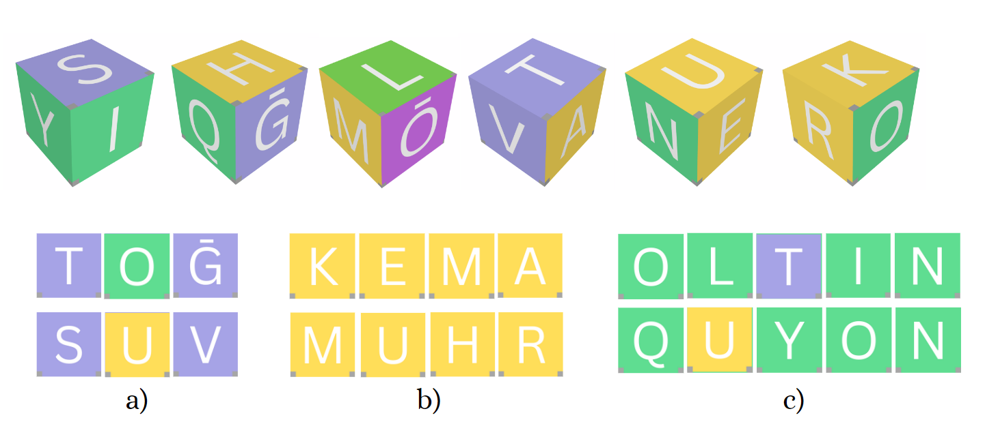
examples of the letter-matching word game
for the Uzbek language

Slide 6
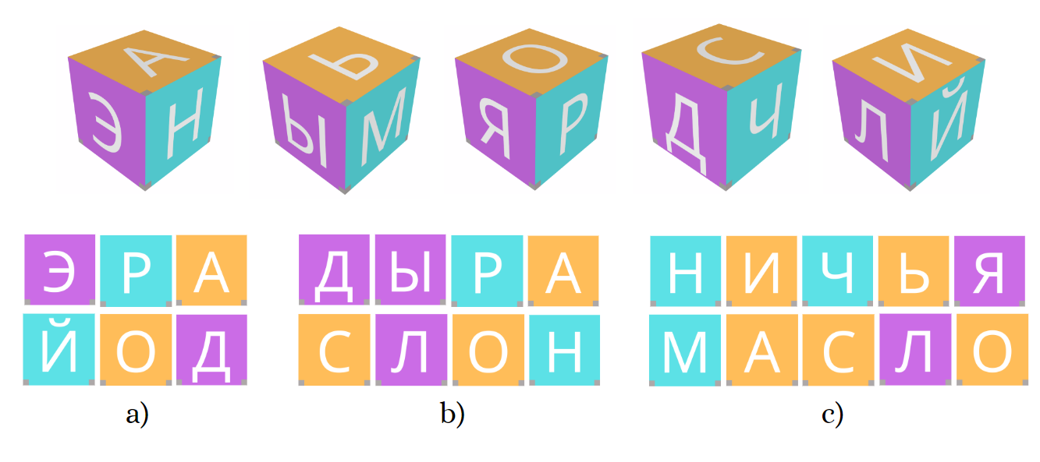
examples of the letter-matching word game
for the Russian language
The input dataset consisting of 3-5-letter words is given, our task is to suggest a set of letters to be described in cubes for the matching letter game. There are six sides of a cube, and a letter will be placed on each side of it. Before the design, a game needs to identify the number of cubes. We select the cases of five, six, seven, and eight as the number of cubes because these types of cubes are appropriate to cover 3-5 letter words.
The proposed method should have the opportunity to cover as many words as possible from the words in the selected dataset with a minimal number of cubes.

Slide 7
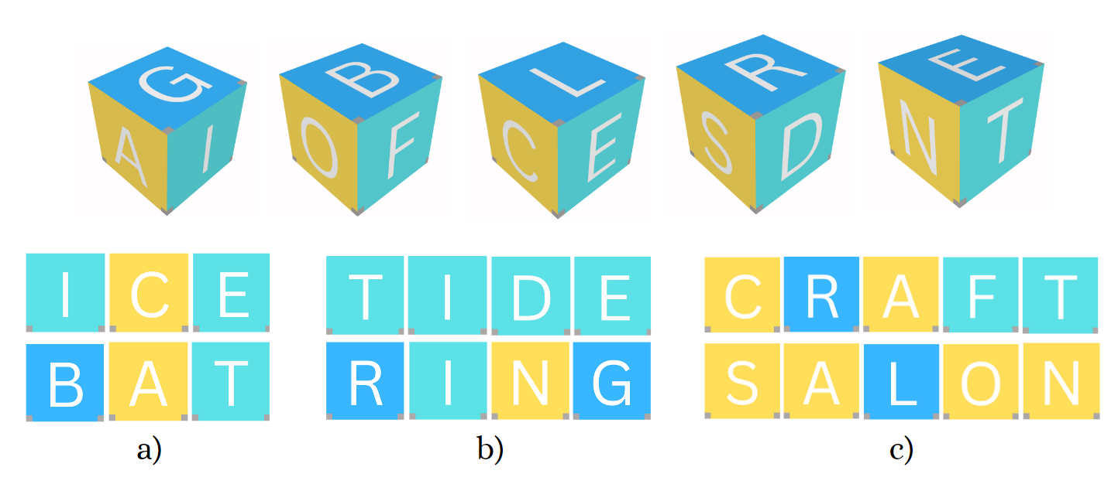
examples of the letter-matching word game
for the English language

Slide 8
Data Preparation
To test our model, We created a new dataset for the Uzbek language by collecting words from literatures of school children and extracting the words from the Madvaliyev and Begmatov dictionary book.
We perform the following steps to simplify the coding: Firstly, in the Uzbek language, There are some digraphs with diacritical signs which cause problems in calculating letter frequency. g’ and o’ replaced with ̄g and ̄o.
Other digraph letters, ch and sh are divided into s and h, two independent letters, while c is not a letter for the Uzbek alphabet.
The Uzbek alphabet has a character that is called a phonetic glottal stop. Although it is not a real letter, still it is considered a part of the Uzbek alphabet. The words with this character consist of only 18 words in the Uzbek dataset, therefore we omitted these words in the filtering process.
After the normalization, 7948 words with 3-5 characters are left in our dataset. Then these words were filtered by a native Uzbek speaker and an expert in Uzbek linguistics by removing very rare words and unfamiliar words for school children to create a final dataset

Slide 9
Statistics
We calculated the statistics for positional distribution of letter on the selected datasets to find out the regularities between occurrence of vowels and consonant in word.
Uzbek language has 27 letters and six of them are vowel phonemes: a, e, i, o, u, o‘;
English alphabet consists of 26 letters including 5 (a, e, i, o, u) vowels;
Russian alphabet consists of 33 letters including 10 {а, у, о, ы, и, э, я, ю, ё, е) vowels;
The Slovenian alphabet includes 25 letters which 5 of them are vowels a, e, i, o, u.

Slide 10
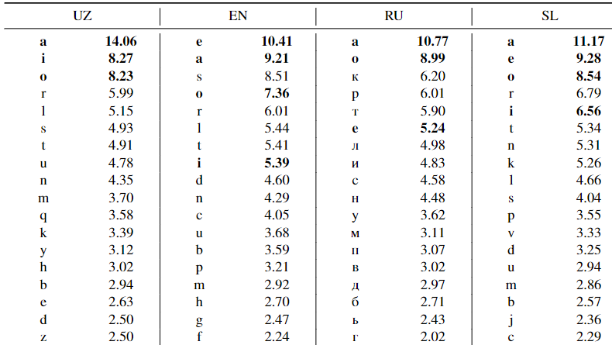
Letter frequencies for the dataset represented letter
and its frequency in percentage
It can be seen from table that most of the vowels have high frequencies in all languages, which means that vowels actively participate to form words.
Considering the active participation of vowels in the formation of words, we study the dynamics of positional occurrences of letters in vowel and consonant level for the selected datasets.

Slide 11
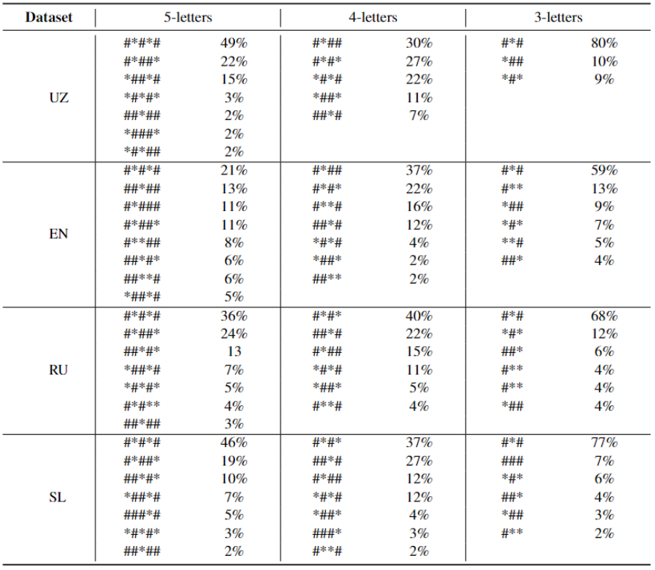
positional occurrences of letters
Common pattern of vowel and consonant letter positional occurrences and its portion within 3-5 letters word for each the datasets (* - Vowel, # - Consonant).
Although the word length (3-5 letter) is short A vowel’s frequency is higher in the words which have short length (3-5 letter). In order to increase the possibility of making words, we can increase the number of vowels in a game cubes.

Slide 12
Developed Models
Letter frequency (LF) model
Vowel Priority (VL) model

Slide 13
Letter frequency (LF) approach
We propose a model based on Letter (Uni-gram) Frequency and Bi-gram Frequency.
We calculate character level frequencies of Uni-gram and Bi-gram for words from the dataset.
Both frequencies are sorted by descending order of value.
Generate a sequence of letter from the Bi-gram frequency depending on the position of the list, all letters participate once.
Remaining part of the sequence is derived from Letter Frequency list, then it is sorted by Bi-gram frequency value.
The generated sequence of letters is arranged in the form of cubic letters.
LF algorithm shown in Algorithm 1.

Slide 14
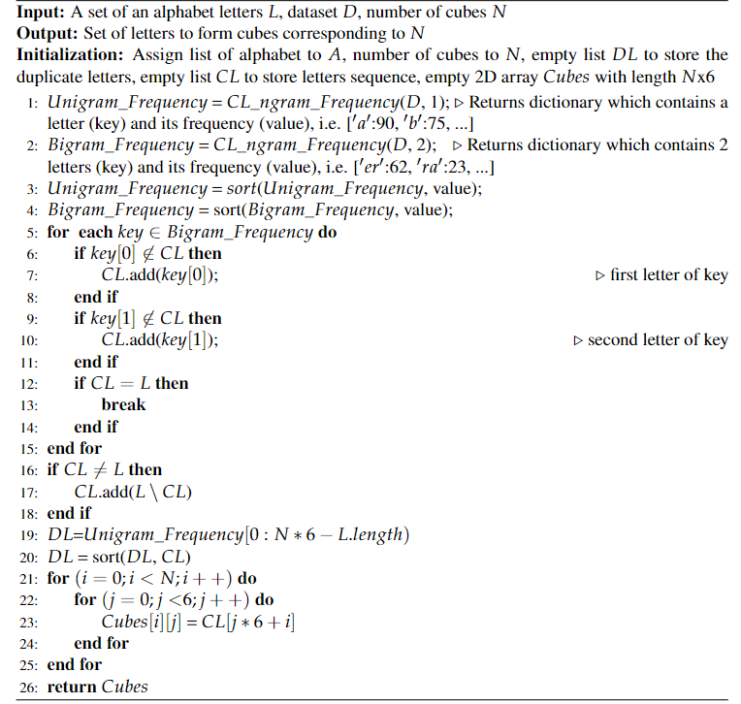
Algorithm 1: Designing of letters for cubic game based on LF approach

Slide 15
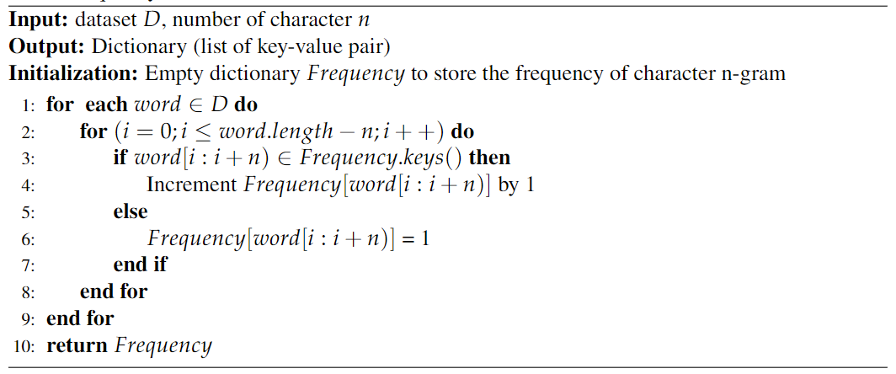
Algorithm 2: Method to calculate of character-level n-gram model frequency (CL_ngram_Frequency)

Slide 16
Vowel Priority (VL) approach
We propose a method based on Bi-gram frequency, set of vowels and set of frequent vowels.
We calculate character level frequencies of Bi-gram for words from the dataset and sorted by descending order of value.
Both frequencies are sorted by descending order of value.
Generate a sequence of letter from the Bi-gram frequency depending on the position of the list, all letters participate once.
Set of Vowels and Frequent Vowels are added to the sequence of letter.
The generated sequence of letters is placed in the form of cubic letters.
VL algorithm shown in Algorithm 3.

Slide 17
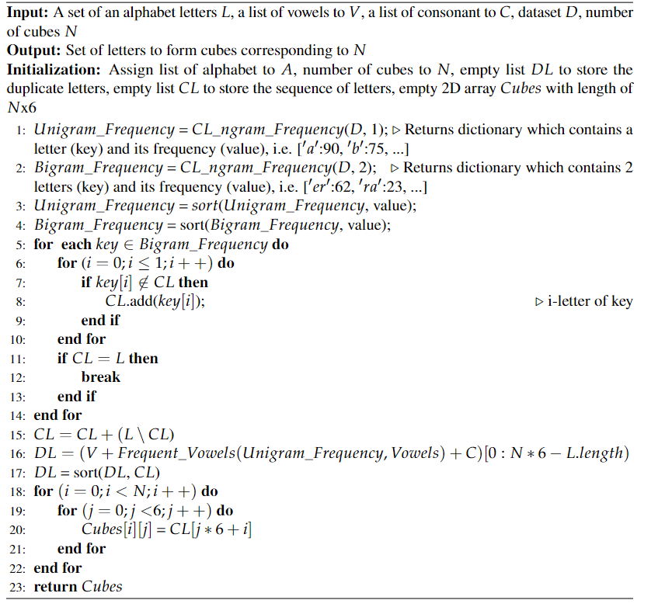
Algorithm 3: Designing of letters for cubic game based on VL approach

Slide 18
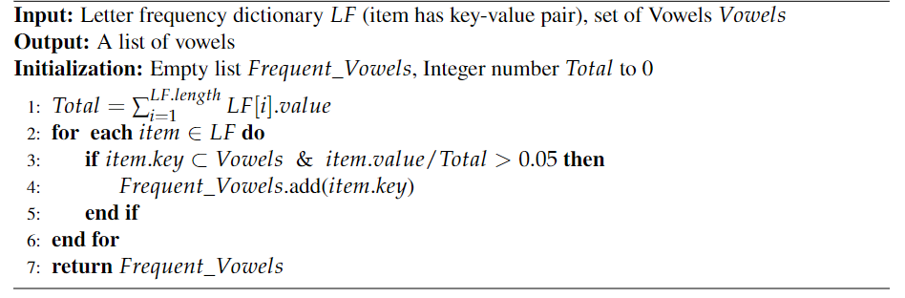
Algorithm 4: Frequent_Vowels method returning a subset of vowels that the frequencies are higher than 5% of the dataset

Slide 19
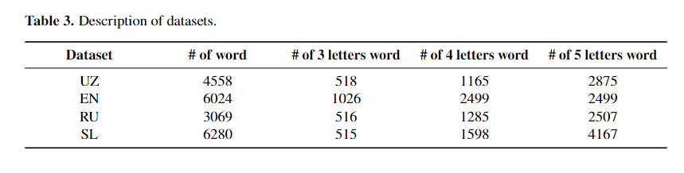
Description of the datasets
To evaluate our models, are taken four datasets from Uzbek, English, Russian and Slovenian languages. Since our main goal is applying the proposed model for Uzbek languages, we created a new dataset by involving language experts. The detailed information about datasets are presented following table:

Slide 20
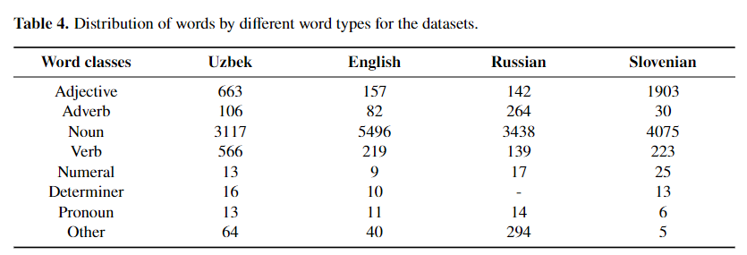
Distribution of words

Slide 21
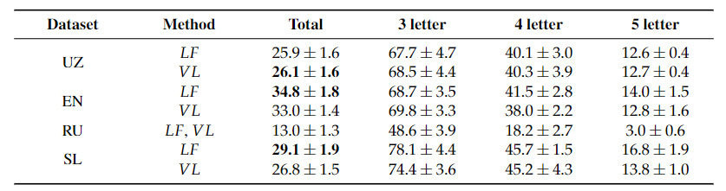
Experimental Results
Table 5. Overall coverage (%) with standard deviation of both methods in case of 5 cubes
Both models got lower coverage in all datasets for 4-5 letter case. Because the probability of constructing 4-5-letter words (especially, 5-letter words) with 5 cubes is really low.
Both models obtained low result on Russian dataset. The reason is that the cubic letters (30 letters for 5 cubes) does not include all the alphabet letters.

Slide 22
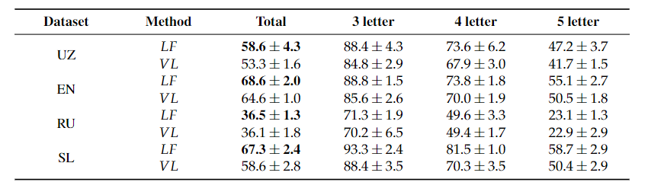
Experimental Results
Table 6. Overall coverage (%) with standard deviation of both methods in case of 6 cubes
Overall coverages of both models were improved around 30% in all datasets comparing to the case of 5 cubes.
LF approach achieved higher accuracies than VL method in all cases with 3, 4 and 5 letter.

Slide 23
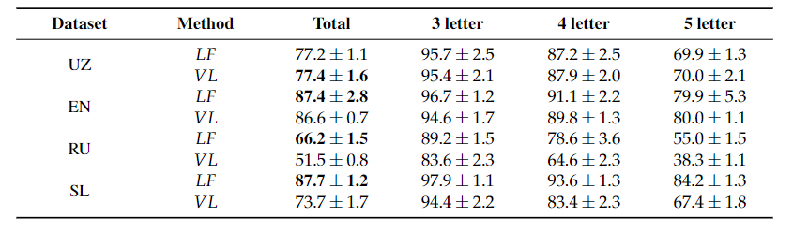
Experimental Results
Table 7. Overall coverage (%) with standard deviation of both methods in case of 7 cubes
LF method achieved reasonable high coverages (over 90%) on English and Slovenian languages in 3-4 letter cases.
Although VL gained comparable result with LF model on Uzbek and English datasets, it got approximately 15% lower average coverage on Russian and Slovenian datasets.
The average coverage of both model increased around 17-20% for the case of 5-letter in all datasets comparing 6 cubes case.

Slide 24
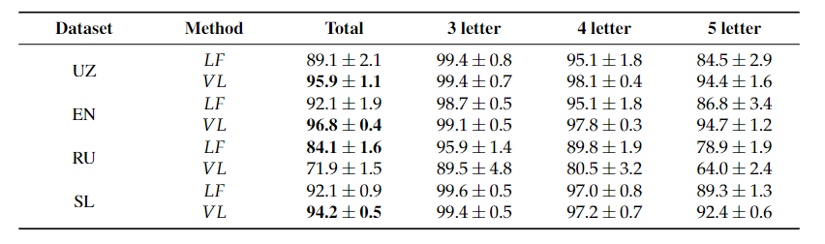
Experimental Results
Table 8. Overall coverage (%) with standard deviation of both methods in case of 8 cubes
The results shown in table that VL model achieved better coverage than LF model on all datasets except Russian

Slide 25
Discussion of results
The results in Table 8 show that VL model achieved better coverage than LF model on all datasets except Russian.
Improvement of VL model was 7% for Uzbek, 4.7% for English and 2.1% for Slovenian language comparing to LF model. The main reason is that the VL model includes more vowel letters in the case of 8 cubes comparing to the case of 5, 6 or 7 cubes.
In general, both model achieved higher result in all datasets with the case of 8 cubes, especially, over 98% in 3-letter case and over 95% in 4-letter case for Uzbek, Slovenian and English datasets. This is an expected behavior, because the chance of constructing 3-4-5 letter words from 8 cubes (48 letters) becomes really high.
In all experiments, VL method got lower result than LF approach on Russian dataset, because when the number of cubes is increased, proposed methods tend to get a reasonably high coverage on all datasets. We achieved the intended coverage with 8 cubes, therefore 8 cubes was the last case of experiment.

Slide 26
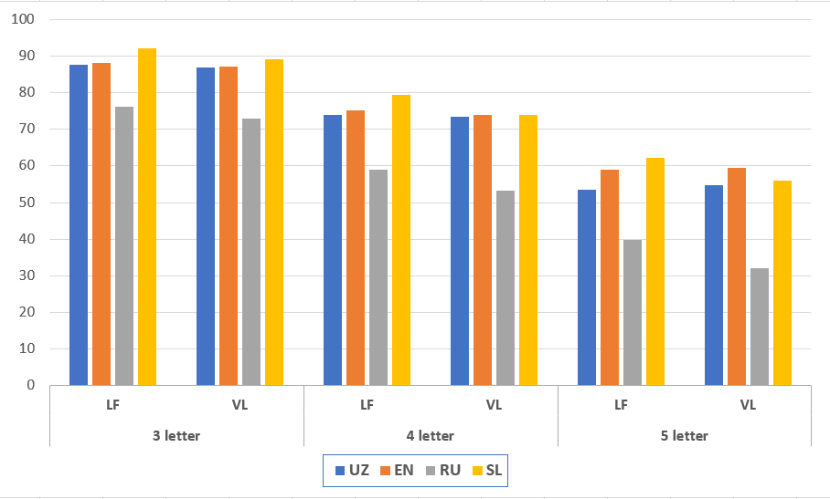
Comparison of LF and VL models on average coverage in the case of 5-8 cubes

Slide 27
Comparison of LF and VL models on average coverage in the case of 5-8 cubes
Above figure illustrates that both models achieved comparable results in terms of average coverage over 5-8-cubes conditions. LF method gained slightly better results than VL method on 3-4-5 letter average coverage for Slovenian and Russian datasets, while this result was comparable on Uzbek and English datasets.

Slide 28
Conclusion
A matching-letter game is an essential tool for a child to improve their letter recognition and vocabulary as well as orthography.
In this paper, we proposed two models based on Letter Frequency (LF) and Vowel Priority (VL) methods for modeling a cubic-oriented word game.
Experimental evaluations show that both models have their advantages depending on the number of cubes.
In the case of 8 cubes, VL model (over 94%) achieved higher overall coverage than LF approach (over 89%) on Uzbek, English and Slovenian datasets because those languages have less number of vowels which are frequent in those datasets.
Both models covered around 99% of 3-letter words in Uzbek, English and Slovenian datasets while this coverage was over 85% in 5-letter words.
Developed models can be applied to other languages by providing their alphabets and datasets consisting of 3-5 letter words.

Slide 29
Thank you very much!
Questions?

